Slide 1


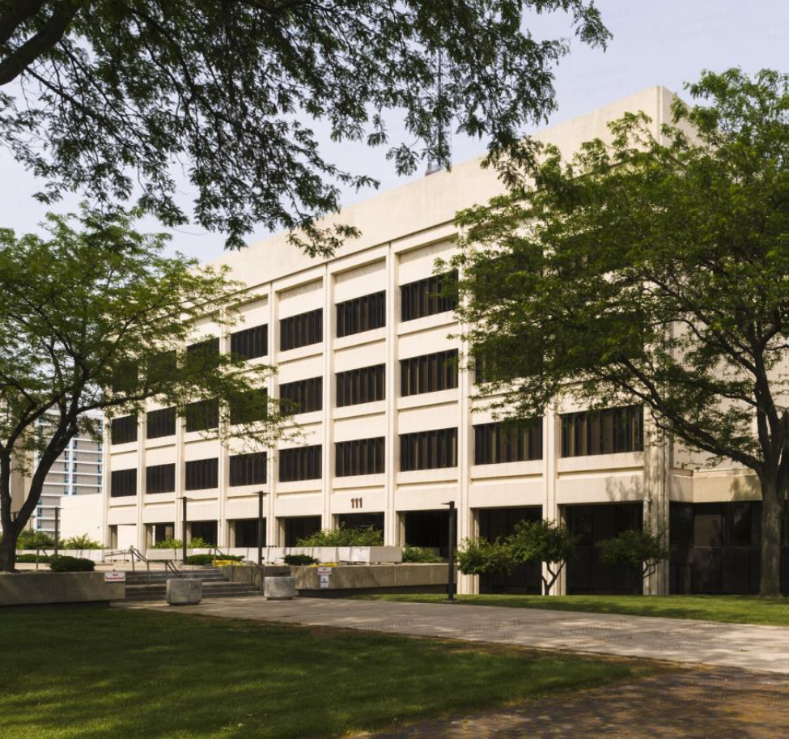
STATE OF THE COUNTY
2024
Chairman Christopher S. Boyd

Slide 2
HOW ‘BOUT THEM LIONS!

Slide 3



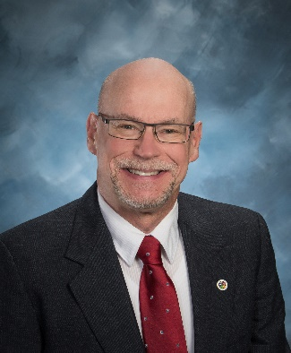



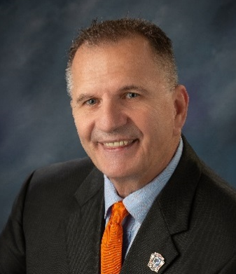
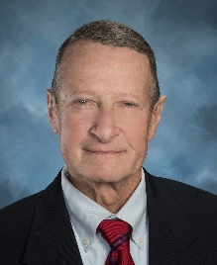
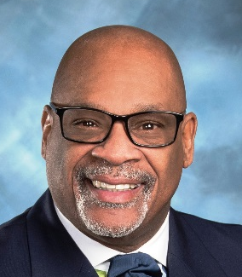
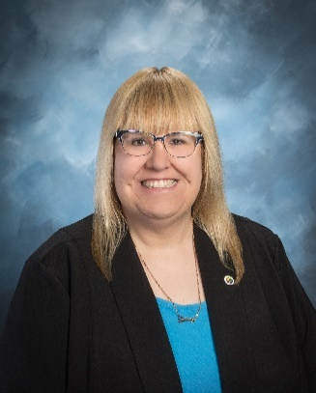
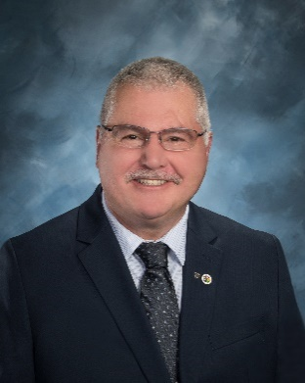


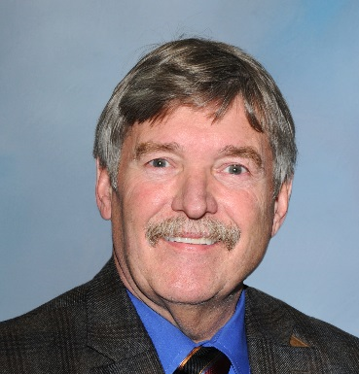
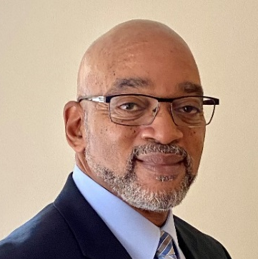
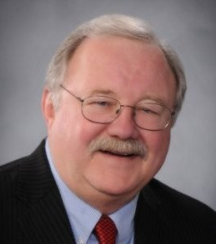

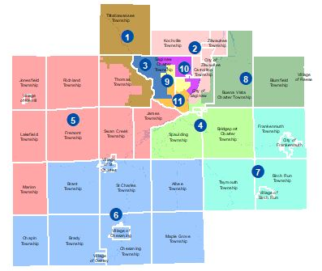
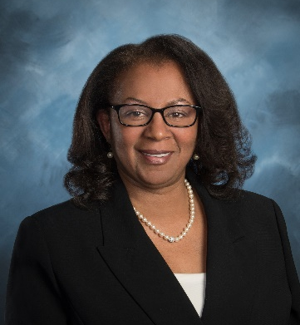

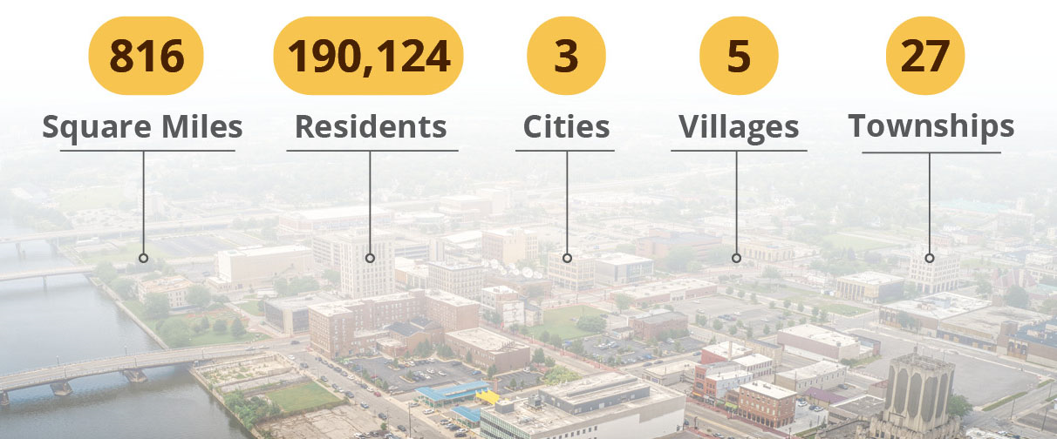

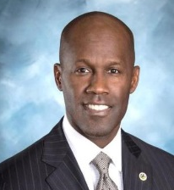
DISTRICT 1 MARK PIOTROWSKI DISTRICT 7 DENNIS KRAFFT
DISTRICT 2 JACK TANY DISTRICT 8 GERALD LITTLE
DISTRICT 3 RICHARD SPITZER DISTRICT 9 CHRISTOPHER BOYD
DISTRICT 4 SHELDON MATTHEWS DISTRICT 10 LISA CONEY
DISTRICT 5 TRACEY SLODOWSKI DISTRICT 11 MICHAEL WEBSTER
DISTRICT 6 DENNY HARRIS

Slide 4
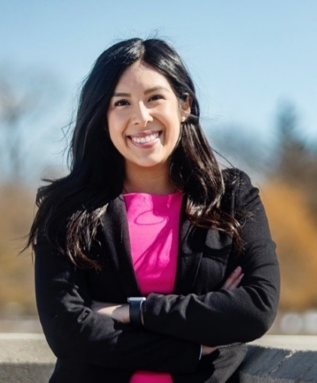
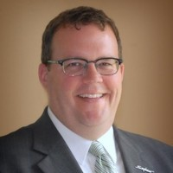
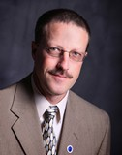
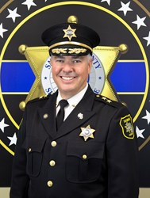
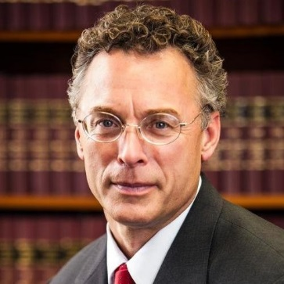
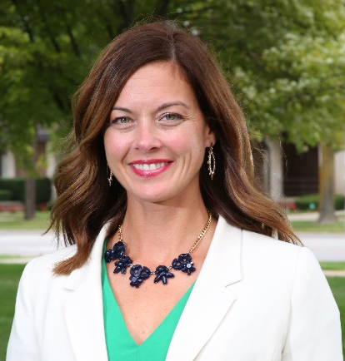

Elected Officials
Tim Novak
Treasurer
Vanessa Guerra
County Clerk
Brian Wendling
Public Works
Bill Federspiel
Sheriff
John McColgan
Prosecuting Attorney
Katie Kelly
Register of Deeds

Slide 5
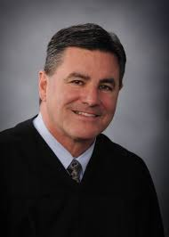
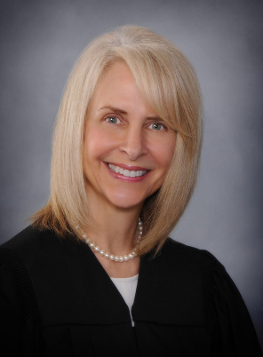
Saginaw County Judges
Probate Court
Chief Judge Patrick McGraw
Barbara Meter

Slide 6

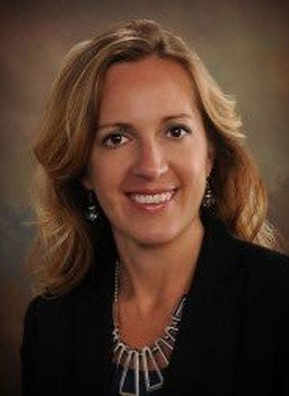
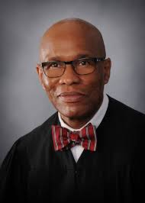
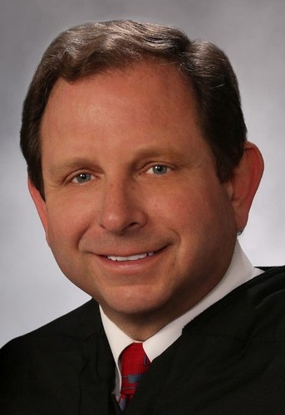
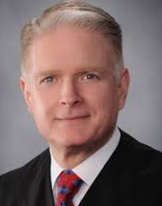
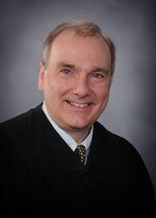
Saginaw County Judges
Elian Fichtner
Terry Clark
David Hoffman
M. Randall Jurrens
A.T. Frank

Slide 7
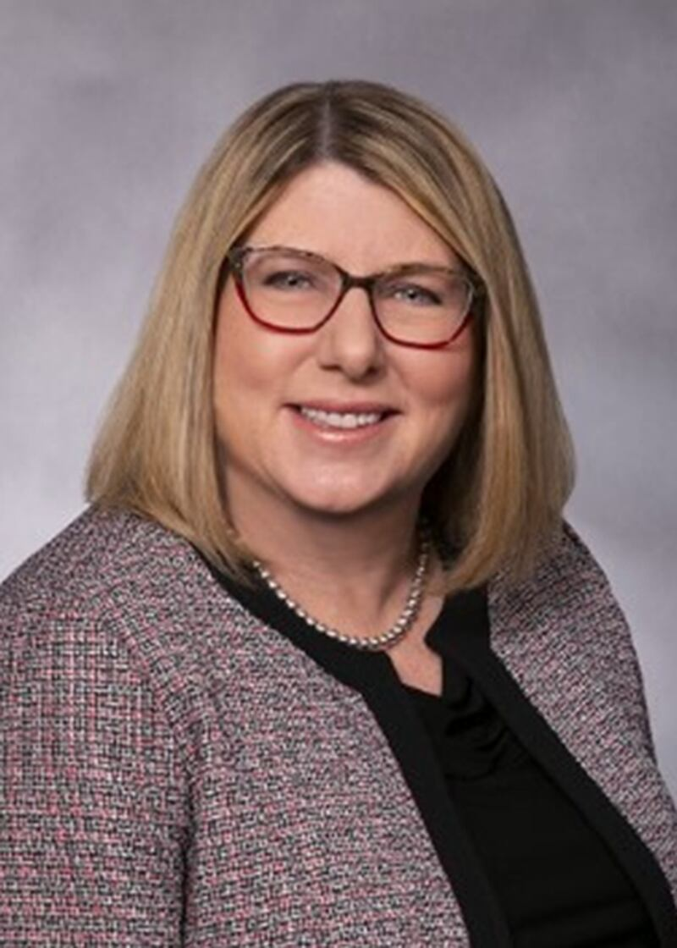
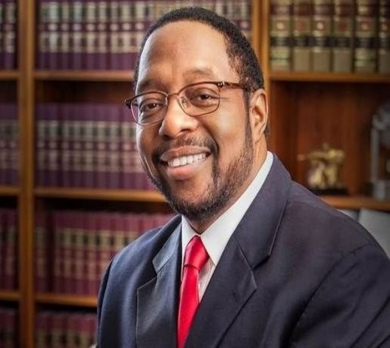
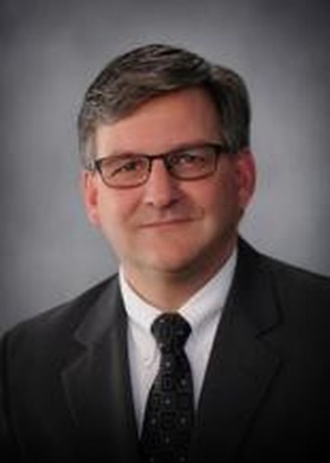
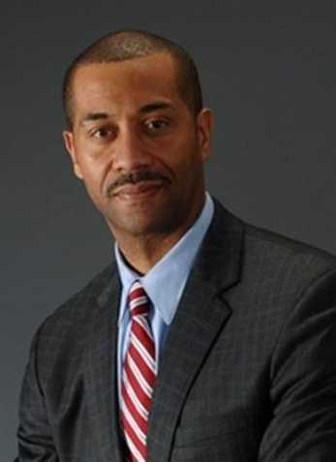
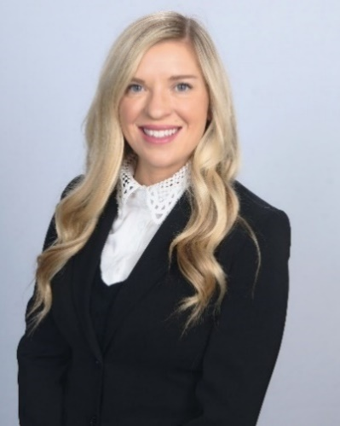
Saginaw County Judges
10th Circuit Court
Chief Judge
Julie Gafkay
Darnell Jackson
André Borrello
Manvel Trice
Brittany Dicken

Slide 8
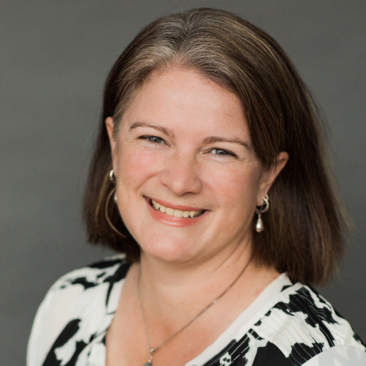
Please Offer a Warm Welcome to our New
County Administrator!
Mary Catherine Hannah
______
Former County of Alpena Administrator

Slide 9
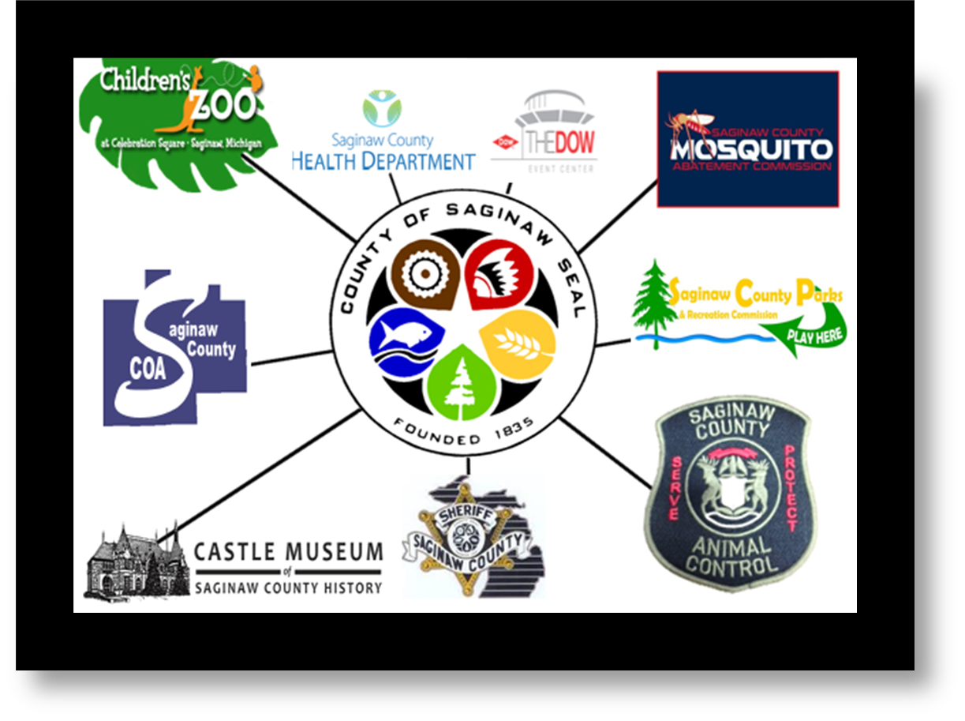
Our Services
Administrator’s Office –
Personnel, Accounting, Benefits & Payroll
Animal Care & Control
Board of Commissioners
Circuit Court
County Clerk
Commission on Aging
Community Corrections/Pretrial Services
District Court
Emergency Management
Equalization
Family Court – Juvenile/Probate
Friend of the Court
Harry Browne Airport
Health Department
Juvenile Detention Center
Mental Health Authority
Michigan Works!
Mosquito Abatement Commission
MSU Cooperative Extension
Parks & Recreation
Probate Court
Probation Department
Prosecuting Attorney
Public Works Commission
Register of Deeds
Sheriff’s Office, Jail & Road Patrol
Treasurer

Slide 10
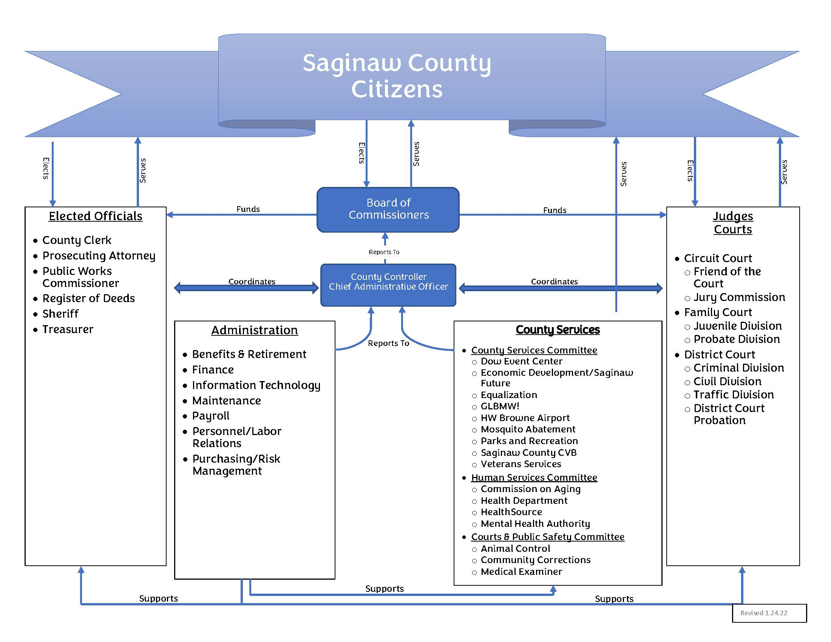
Board of
Commissioners
County Administrator

Slide 11
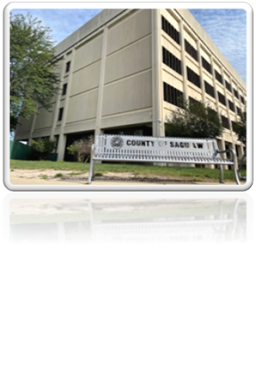
SAGINAW COUNTY’S MISSION
Enhance Quality of Life Through…
Public Safety
Healthcare
Quality Workforce
Economic Development
Natural Resources
Parks and Recreation
Technology
Entertainment
Infrastructure

Slide 12

  Medical Diamond - $30.3 Million state grant and $5 Million ARPA
  Renovations to The Dow Event Center and Parking Structure
  Memorial Cup to be held in Saginaw – Upgrades and Projects
  State grant to Courts to reduce case backlog from COVID-19D
  Animal Care and Control New Building Opening
  Mosquito Abatement Commission Relocation
  ARPA Funding Implementation
  Healthcare programs and costs
  Technology Upgrades
Highlights

Slide 13
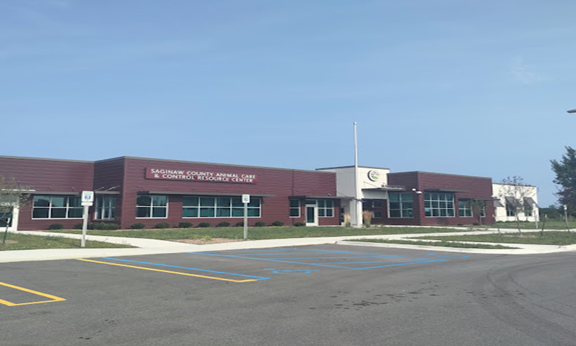
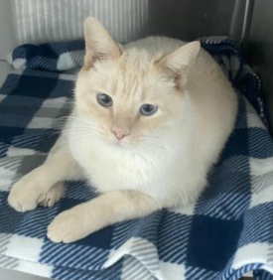
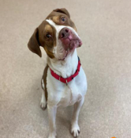
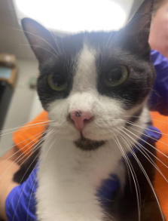

ANIMAL CONTROL SCACCRC BUILDING
New director - Rachel Horton
Advisory Council has been restructured
New training room

Slide 14
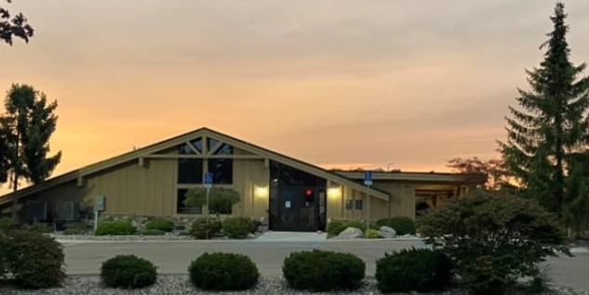
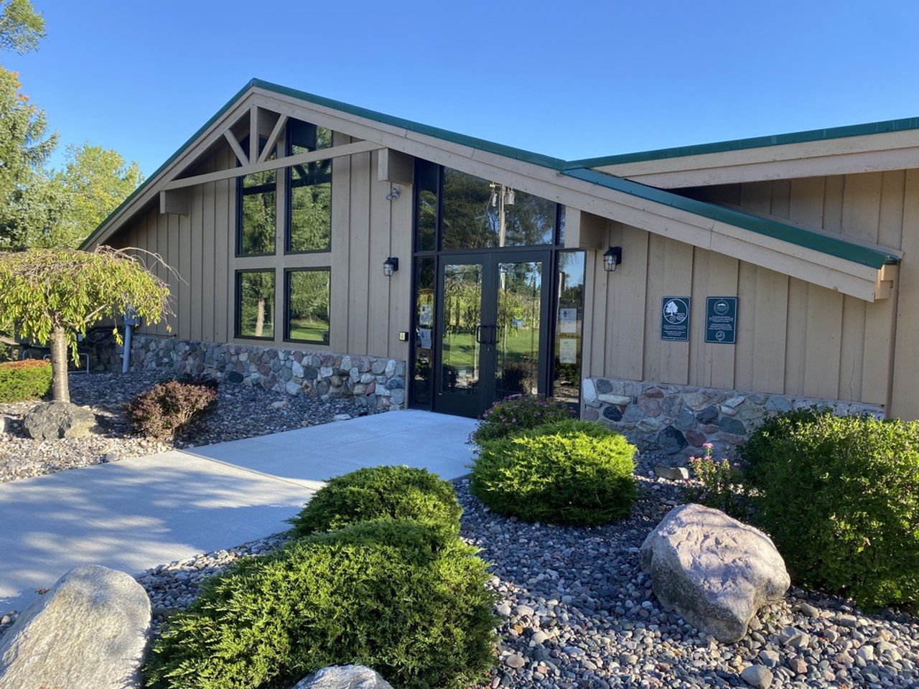
Thomas Township Nature Center and Preserve
Board of Commissioners contributed $300,000
67 Acres
1.3-mile trail
Observation area, sunflower meadow, children’s activity area, and pollinator and serenity garden

Slide 15
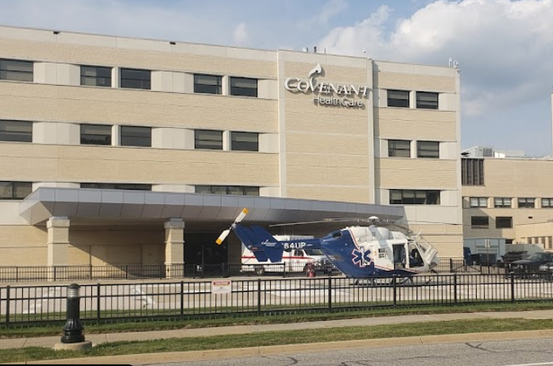
Saginaw County
Medical Examiner’s Office
Return to Saginaw County

Slide 16
Meals on Wheels
Foster Grandparents
Nutrition Education
Senior Centers
Case Management
Care Management for Elderly
Minority Outreach
In-Home Support
Project Lifesaver
Kinship Care
Caregiver Support
Transportation

Slide 17

ARPA FUNDING
2023
- Strengthening County Services
- Saginaw Community Food Club
- Community Action Committee
- Thomas Township Nature Center & Preserve
- Saginaw County Parks and Recreation
- Fire Department Equipment (7 Departments)
- Commission on Aging’s Marie Davis Senior Center
- Chesaning Canoe/Kayak Launch
- First Ward Community Service Center
- Many more Projects
Notes:
ARPA Funding has allowed the county many
opportunities to partner with other organizations

Slide 18

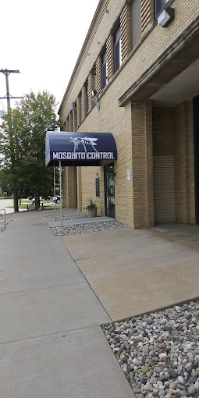
Saginaw Public Schools and Saginaw County collaboration
211 Congress Avenue
705 North Towerline

Slide 19

Looking Forward to 2024
Progress Through Partnership
2024 Canadian Hockey League Memorial Cup
Renovations to the DOW EVENT CENTER
Saginaw Healthcare Strategy
$5 million of ARPA funding
Economic development
Healthcare access
Multiple Revenue Sources
We Welcome A New County Administrator

Slide 20


Slide 21




Estimated $24 Million Economic Impact
May 22 – June 3, 2024
Hosted south of the border for the first time in 26 years
First time in Michigan
County’s Challenge to the City of Saginaw to help build the elevator

Slide 22
Medical Diamond
Project
- Making Progress Toward a Healthier Saginaw -
The plan includes developing properties around Ascension St. Mary’s Hospital, Covenant Medical Center
Expanding Central Michigan University College of Medicine.
State Grant funding of $30.3 Million
Saginaw County contributed $5 million of ARPA funding
City of Saginaw $5 million
Continued support from community

Slide 24
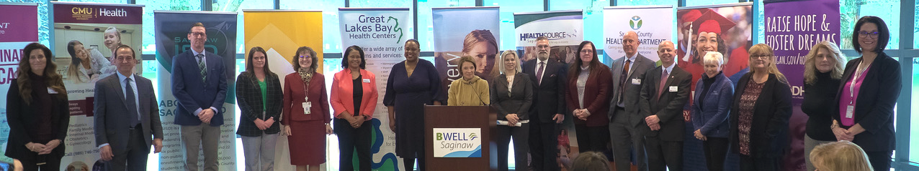



  Health Department is leading a 13-member coalition committed to moving Saginaw from one of Michigan’s unhealthiest communities to the Top 25 healthiest.
  The partners are applying COVID-like urgency to Obesity & Chronic Disease, Mental Health & Substance Use and Maternal & Child Health.
  Plan can be found at bwellsaginaw.org

Slide 25
Saginaw County Courts
Awarded $385,538 Backlog Grant from the State Court Administrative Office
To employ 3 visiting judges and two support staff to assist in reducing backlog of cases
One year: March 2023 – March 2024
Cases reduced from 1,322 to 678
(49% decrease)

Slide 26


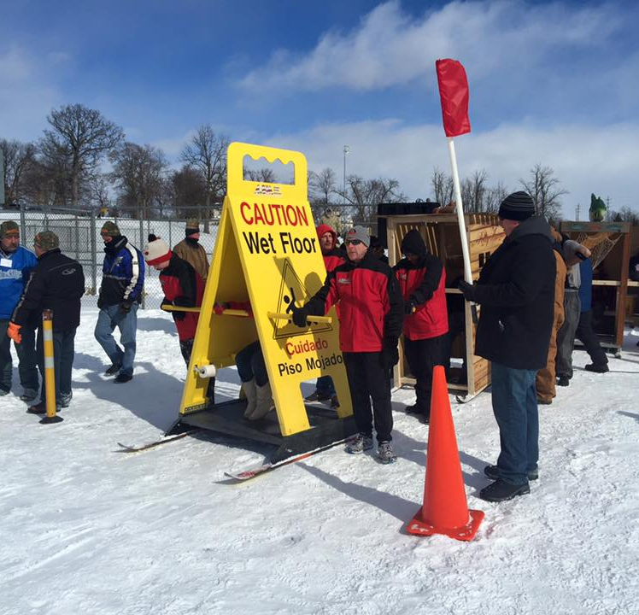
2024 Program Preview
10th Annual Outhouse Race - February 17th, 1 PM Hoyt Park
Walk with Ease Mobility Program – May-June, YMCA of Saginaw
Catch Me If You Can – Family Fishing Festival, Saturday June 1
Over 40 Playdate Programs in our Mobile Recreation Vehicle
Movies in the Park across Saginaw County all summer long
Summer Youth Baseball League at Hoyt Park
3rd Annual Pints & Paddles, September 21, 2024

Slide 27


Slide 28
$58,218,510

Slide 29
$58,218,510

Slide 32

618 Cass Street

Slide 33
BEAD is designed to ensure that every one of Michigan’s unserved and underserved homes and businesses can get connected to high-speed internet infrastructure.
Approximately 30% of Michigan households do not have an affordable, reliable high-speed internet connection that meets their needs.
Michigan received $1.559 billion in Broadband Equity, Access, and Deployment (BEAD) funding to close the digital divide.
The BEAD Program will enable the universal availability of high-speed internet to every home, business, and institution across the state.

Slide 35
Opioid Settlement Funds
$
$1.4 million to Saginaw County
18 years in varying amounts

Slide 36
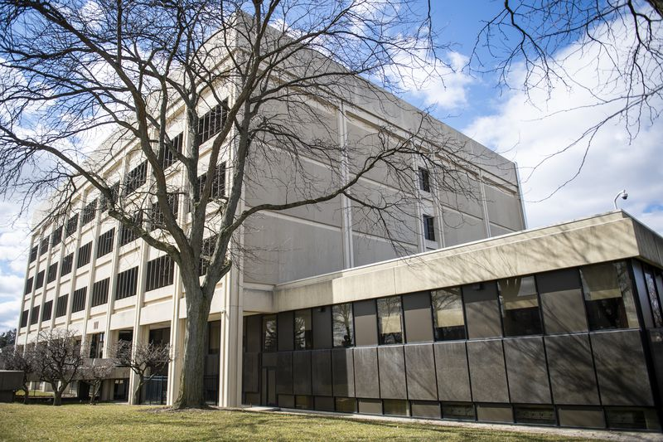
In 2024, ask ourselves how we can play an important part in our vision to contribute to the future successes of our county

Slide 37

Suzy Koepplinger
Marissa Sawdon
For putting this Presentation together!

Slide 38
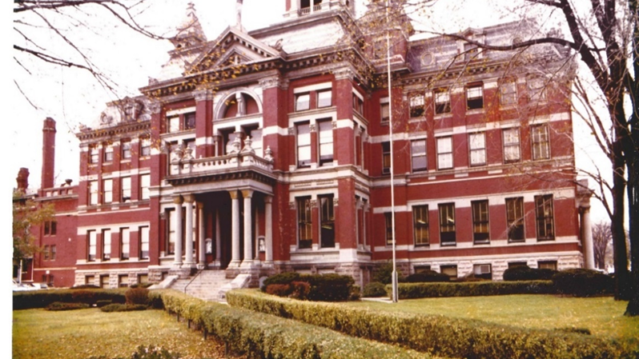
Thanks for coming!

